Slide 1

Digital Image Processing
Chapter5: Image Enhancement
Dr. Mohammad Javad Parseh
Jahrom University
Department of Computer Engineering and Information Technology
October 2024

Slide 2
Introduction
The filter enhances the quality of an image so that important details can be visualized and quantified.
In this chapter, we discuss a few more image enhancement techniques. These techniques transform the pixel values in the input image to a new value in the output image using a mapping function.
We discuss logarithmic transformation, power law transformation, image inverse, histogram equalization, and contrast stretching.

Slide 3
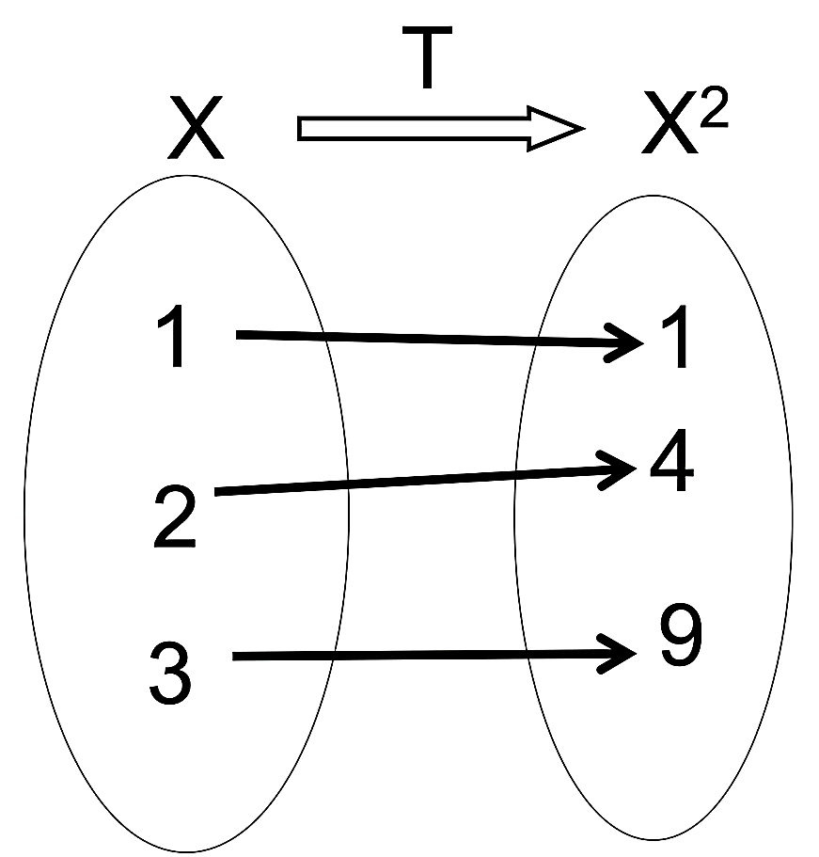
Pixel Transformation
A transformation is a function that maps a set of inputs to a set of outputs so that each input has exactly one output.
In the case of images, a transformation takes the pixel intensities of the image as an input and creates a new image where the corresponding pixel intensities are defined by the transformation.

Slide 4
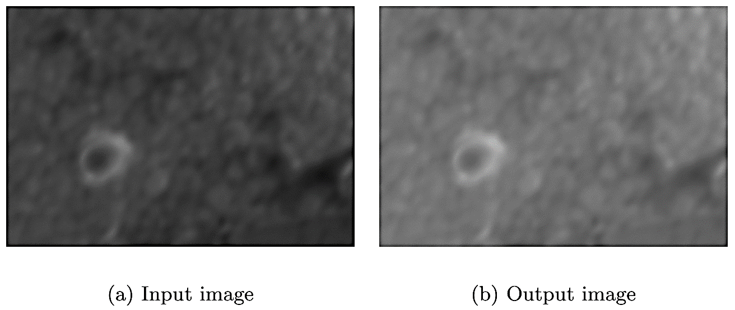
Pixel Transformation (cont.)
Let us consider the transformation, T(x)=x+50. When this transformation is applied to an image, a value of 50 is added to the intensity of each pixel. The corresponding image is brighter than the input image.

Slide 5
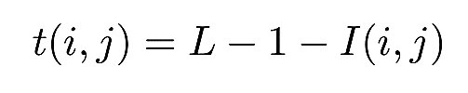
Image Inverse
Image inverse transformation is a linear transformation. The goal is to transform the dark intensities in the input image to bright intensities in the output image and vice versa.
If the range of intensities is [0; L-1] for the input image, then the image inverse transformation at (i,j) is given by the following:
where I is the intensity value of the pixel in the input image at (i,j).

Slide 6
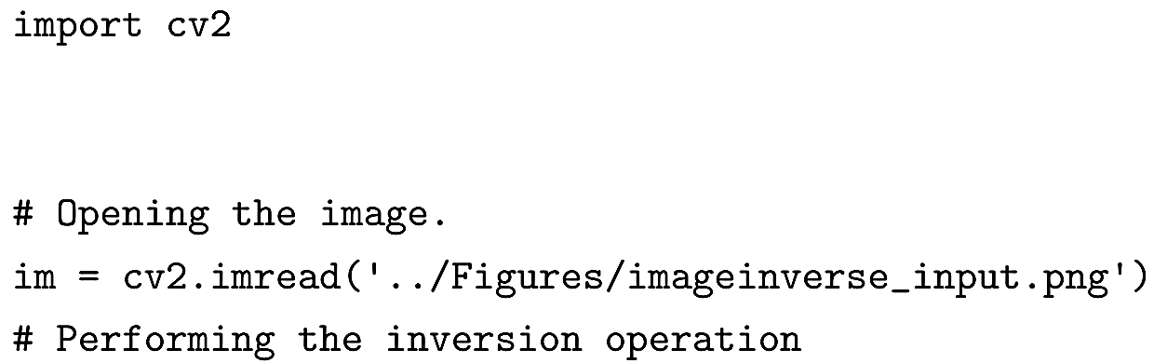
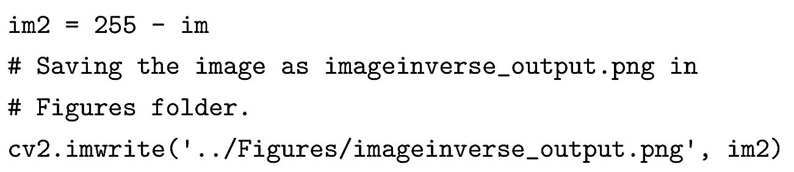
Image Inverse (cont.)

Slide 7
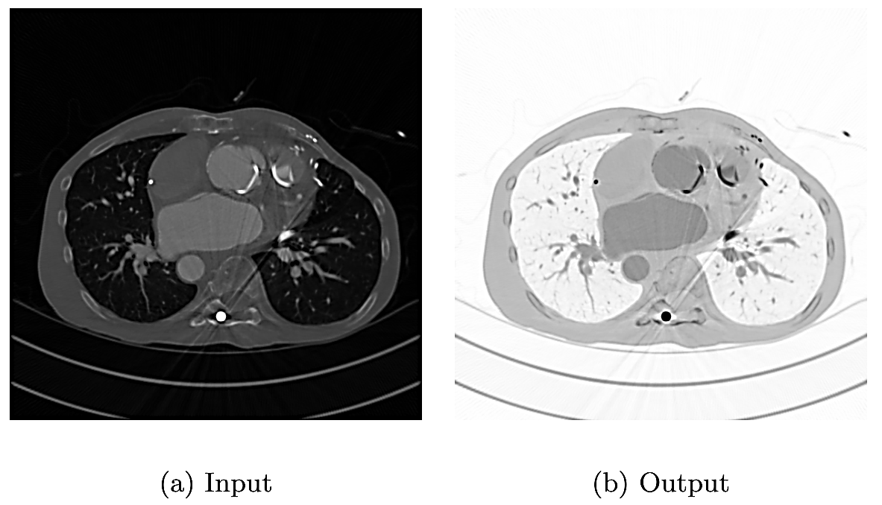
Image Inverse (cont.)
The metal objects are very bright and prevent us from observing other details. The image inverse transformation suppresses the metal objects while enhancing other features of interest such as blood vessels.

Slide 8
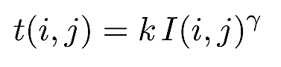
Power Law Transformation
Power law transformation, also known as gamma-correction, is used to enhance the quality of the image. The power transformation at (i,j) is given by:
where k and γ are positive constants and I is the intensity value of the pixel in the input image at (i,j). In most cases k = 1.

Slide 9
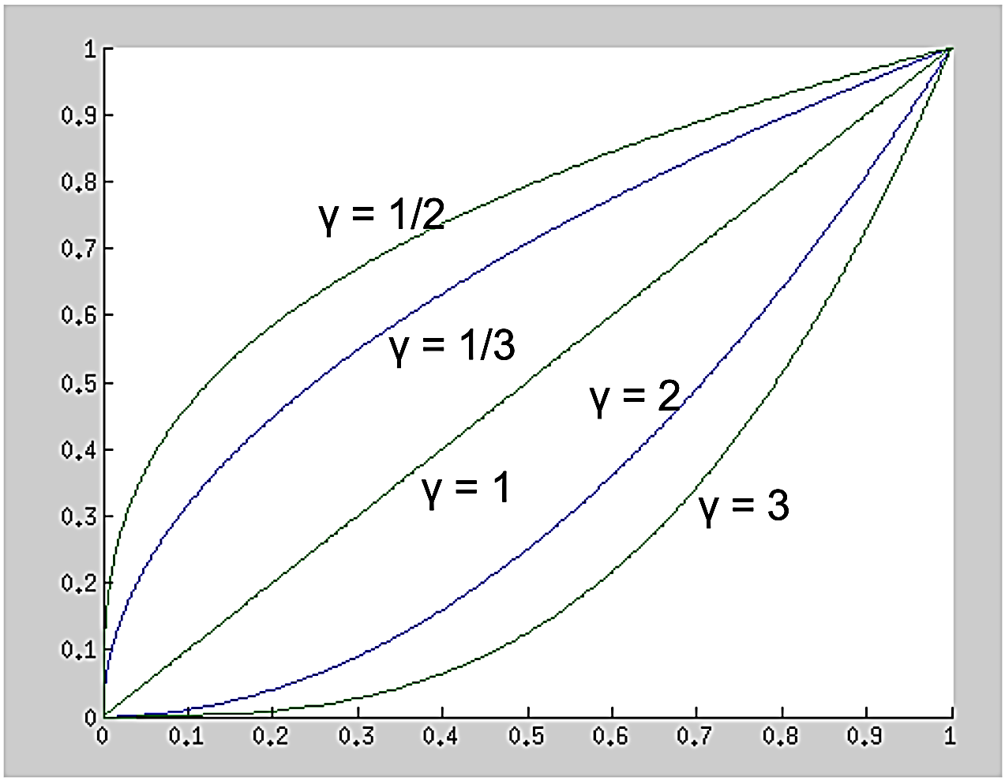
Power Law Transformation (cont.)

Slide 10
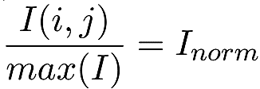
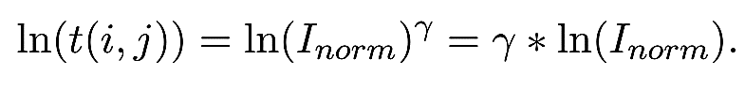
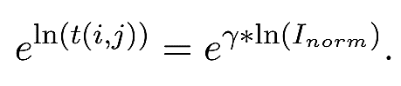
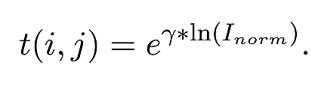
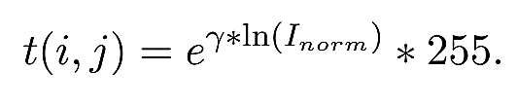
Power Law Transformation (cont.)
In an 8-bit image, the intensity values range from [0; 255]. For γ > 1, output of the transformation will be out of bounds. To avoid this scenario, the pixel intensities are normalized:

Slide 11
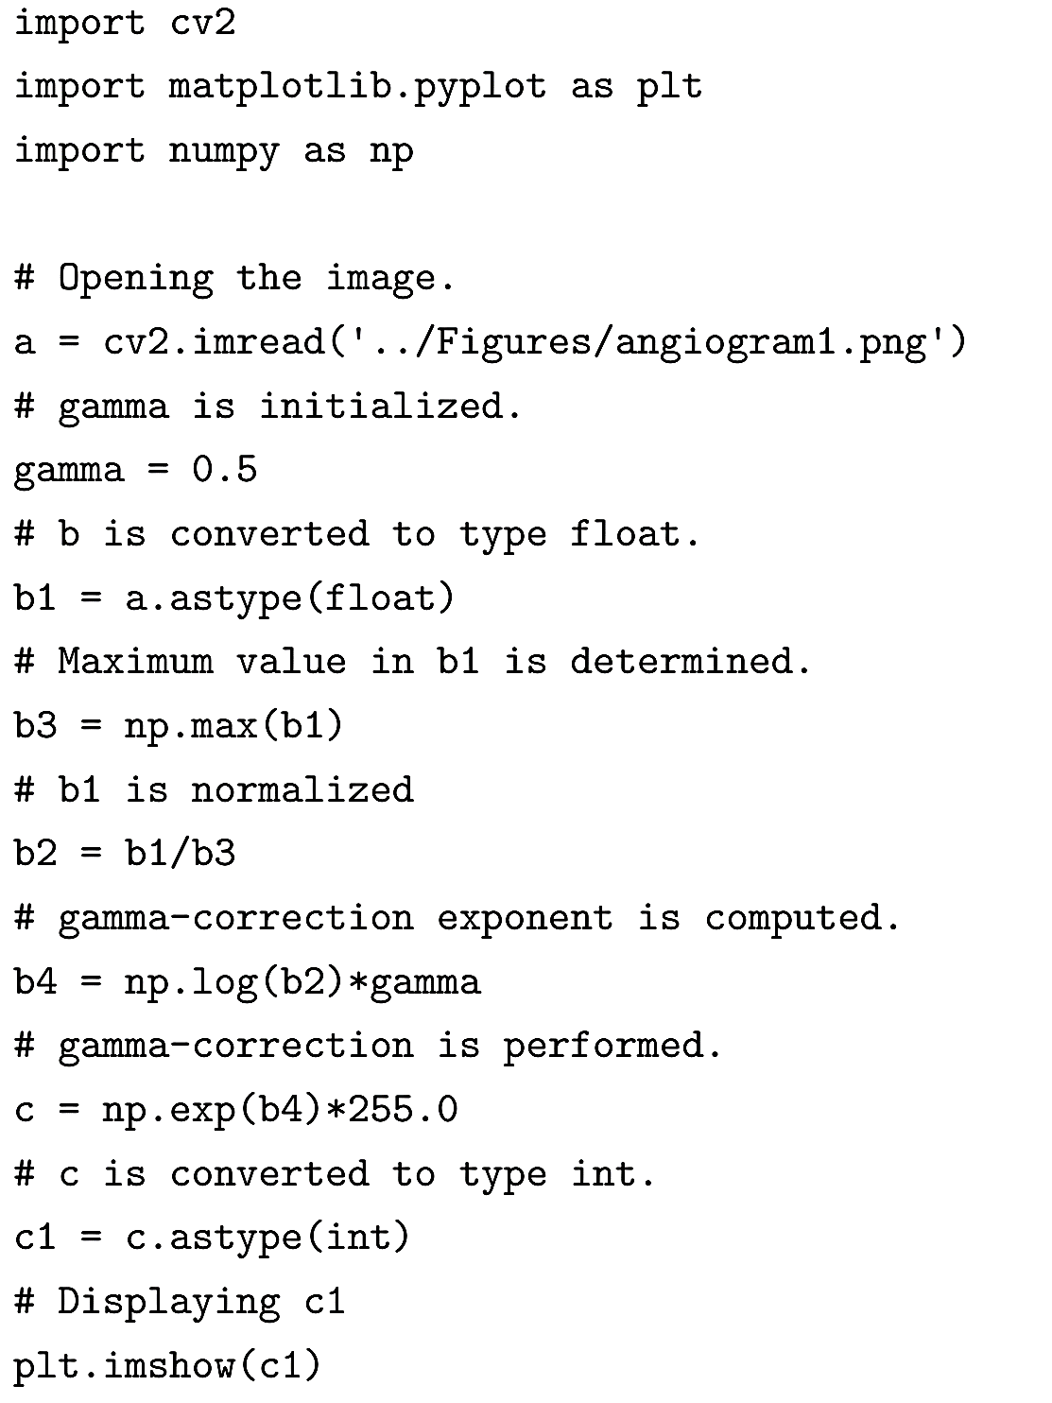
Power Law Transformation (cont.)

Slide 12
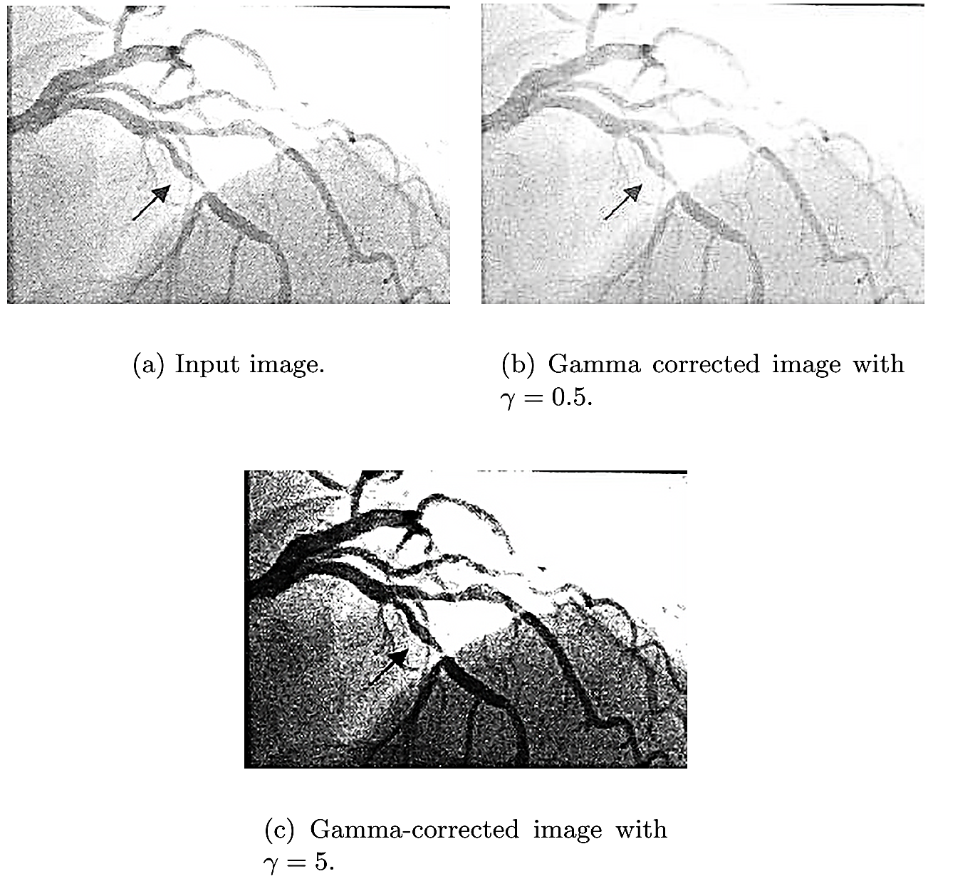
Power Law Transformation (cont.)

Slide 13
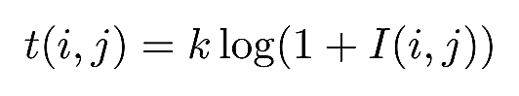
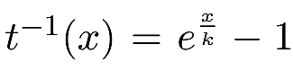
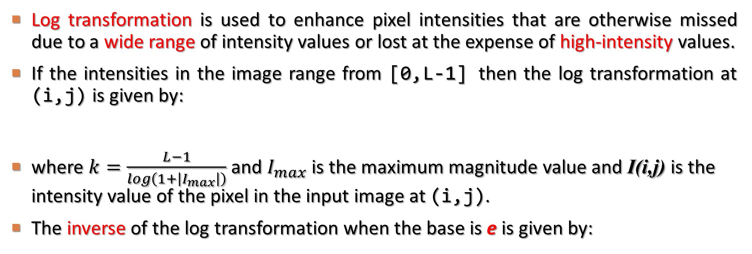
Log Transformation
Log transformation is used to enhance pixel intensities that are otherwise missed due to a wide range of intensity values or lost at the expense of high-intensity values.
If the intensities in the image range from [0,L-1] then the log transformation at (i,j) is given by:
where $k=\frac{L−1}{log\left(1+\left|I_{max}\right|\right)}$ and $I_{max}$ is the maximum magnitude value and I(i,j) is the intensity value of the pixel in the input image at (i,j).
The inverse of the log transformation when the base is e is given by:

Slide 14
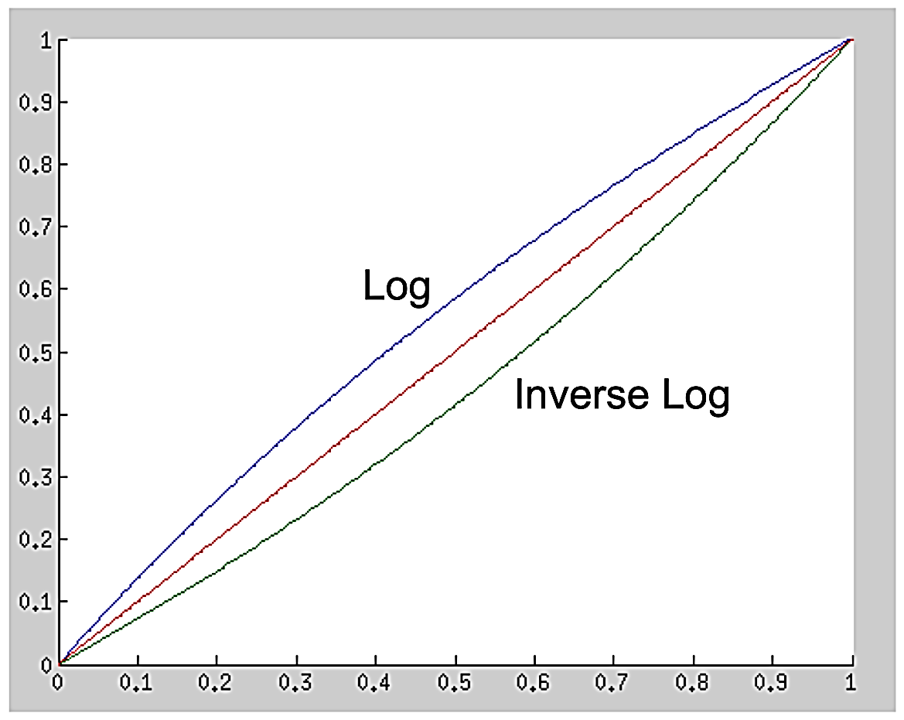
Log Transformation (cont.)
Similar to the power law transformation with γ < 1, the log transformation also maps a small range of dark or low-intensity pixel values in the input image to a wide range of intensities in the output image, while a wide range of bright or high-intensity pixel values in the input image get mapped to narrow range of high intensities in the output image.

Slide 15
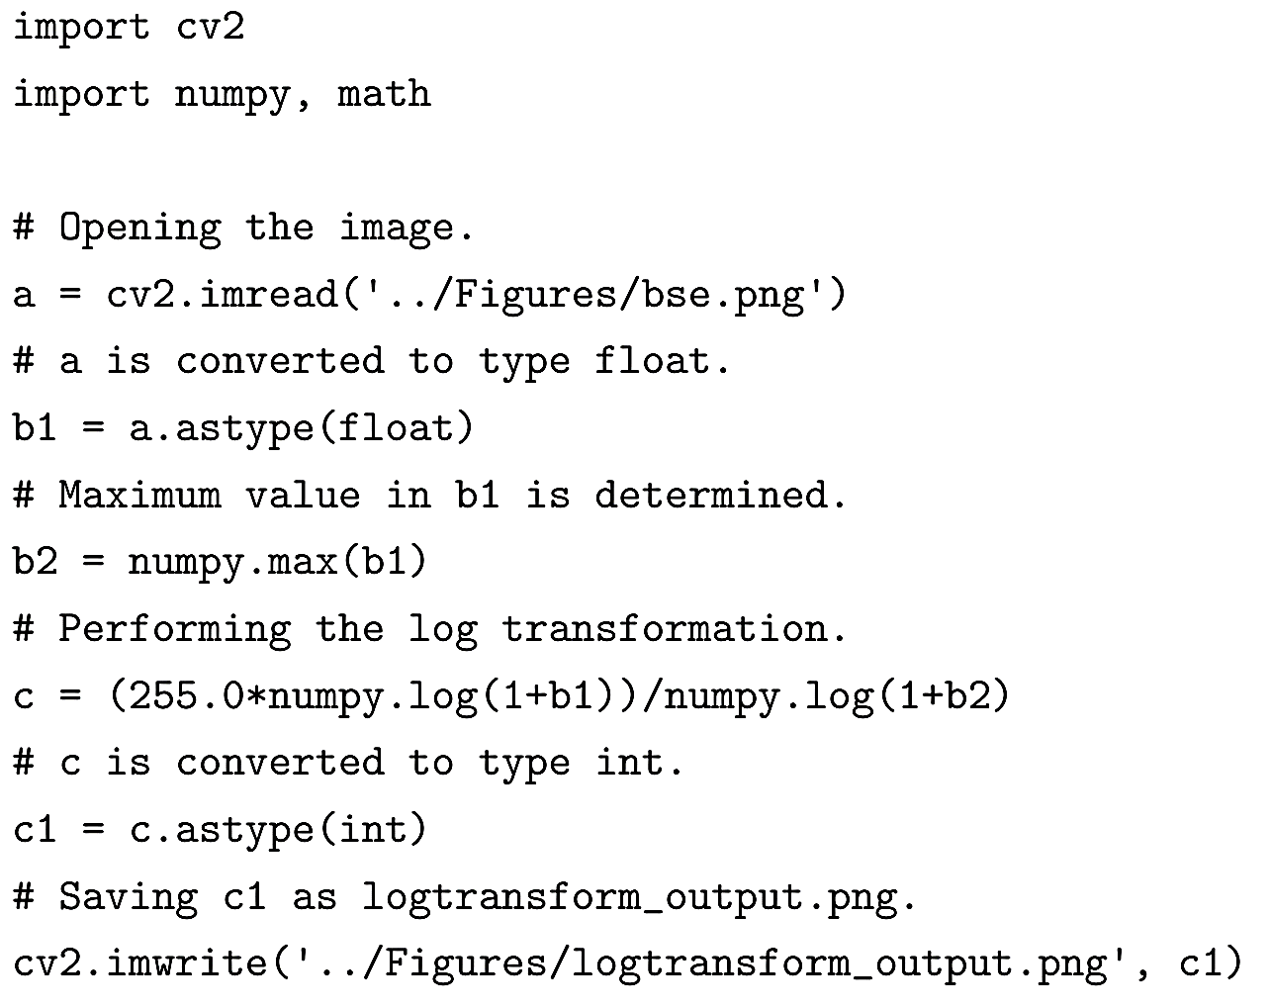
Log Transformation (cont.)

Slide 16
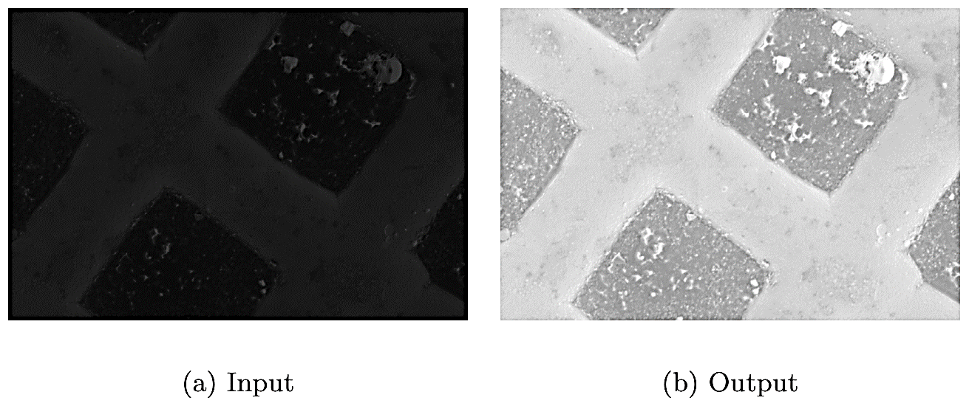
Log Transformation (cont.)
This image is very dark and the details are not clearly visible. Log transformation is performed to improve the contrast, to obtain the output image.

Slide 17
Histogram Equalization
As discussed earlier, low gray-level values in the image (the left side of the histogram) correspond to dark regions and high gray-level values in the image (the right side of the histogram) correspond to bright regions.
In a low-contrast image, the histogram is narrow, whereas in an image with better contrast, the histogram is spread out.
In histogram equalization, the goal is to improve the contrast of an image by rescaling the histogram so that the histogram of the new image is spread out and the pixel intensities range over all possible gray-level values.

Slide 18
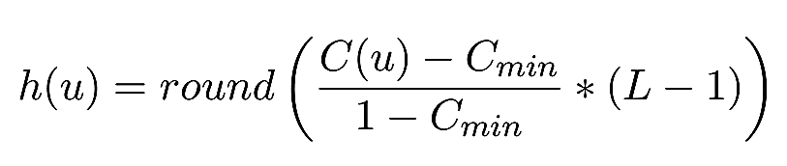
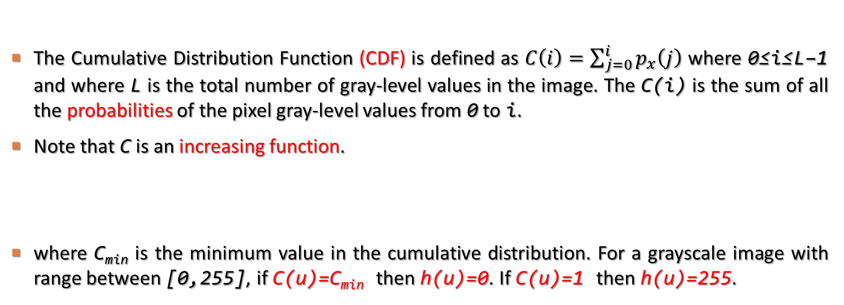
Histogram Equalization (cont.)
The Cumulative Distribution Function (CDF) is defined as $C\left(i\right)=\sum_{j=0}^{i}{p_{x}\left(j\right)}$ where 0≤i≤L−1 and where L is the total number of gray-level values in the image. The C(i) is the sum of all the probabilities of the pixel gray-level values from 0 to i.
Note that C is an increasing function.
where C_{min} is the minimum value in the cumulative distribution. For a grayscale image with range between [0,255], if C(u)=C_{min} then h(u)=0. If C(u)=1 then h(u)=255.

Slide 19
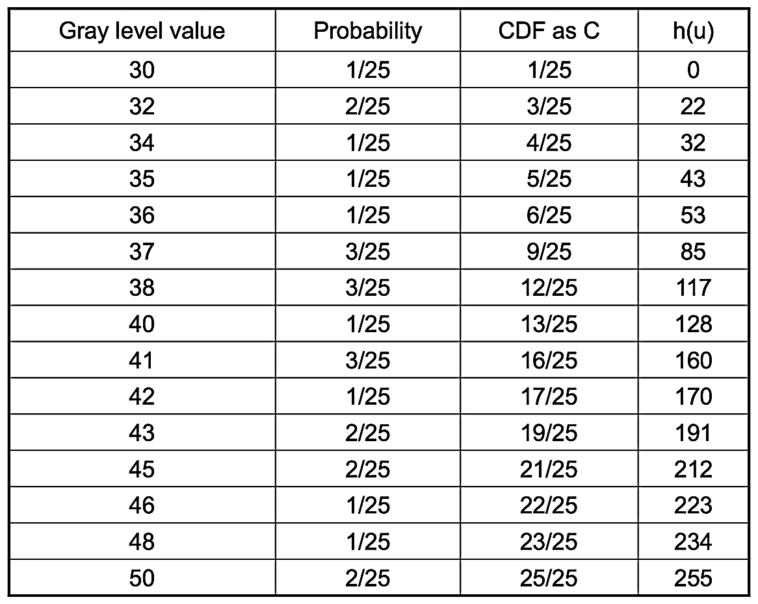
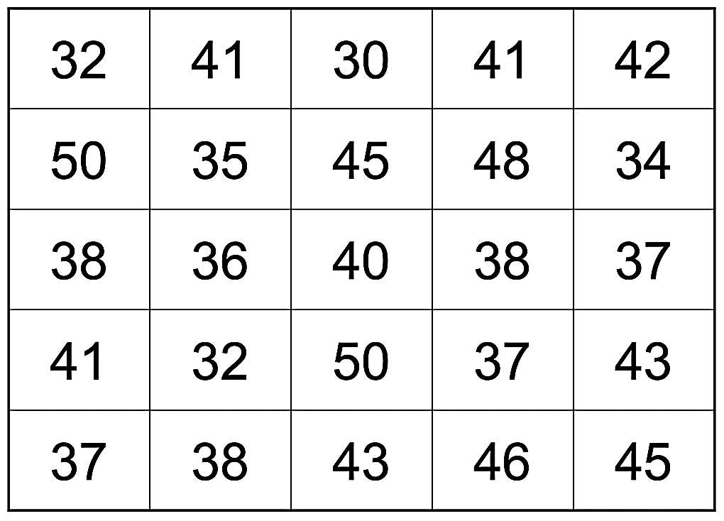
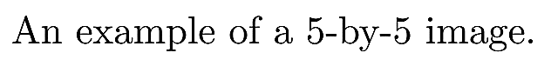
Histogram Equalization (cont.)

Slide 20
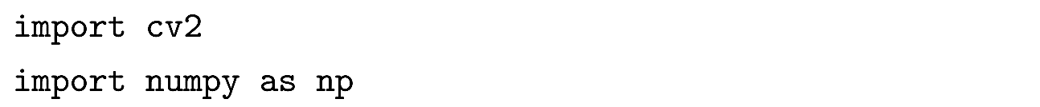
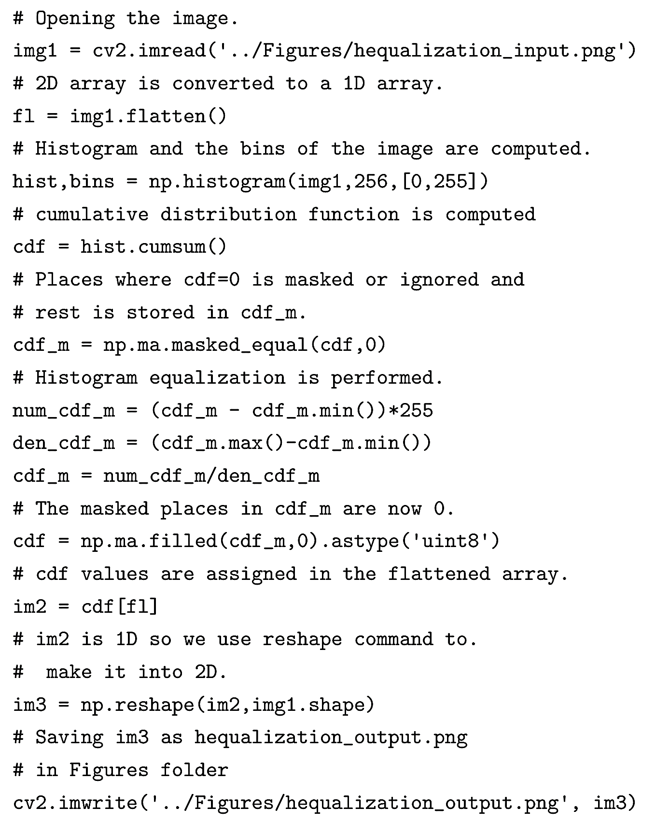
Histogram Equalization (cont.)

Slide 21
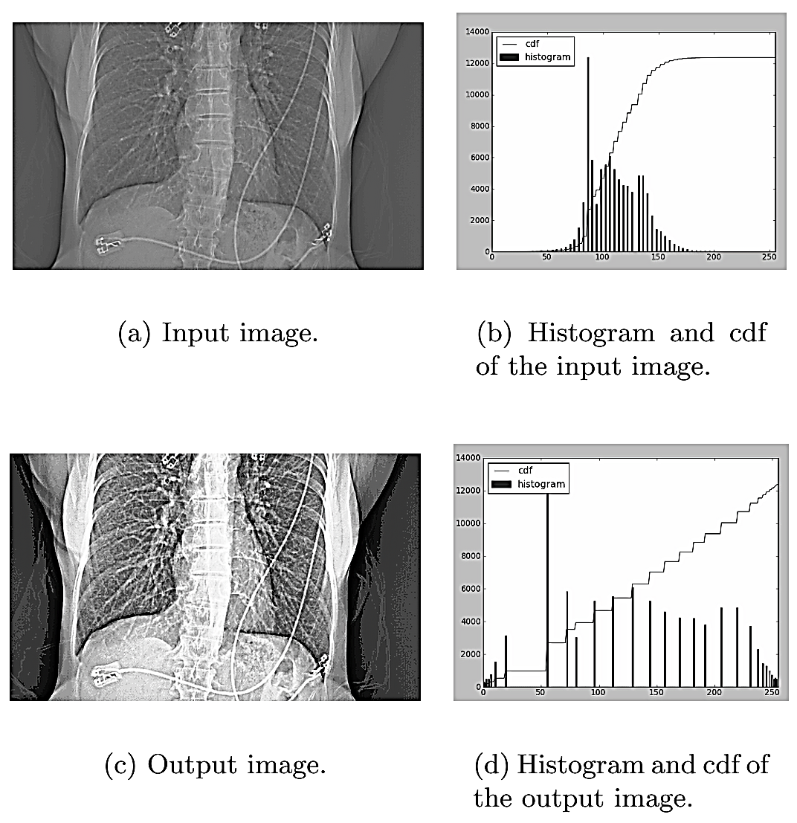
Histogram Equalization (cont.)

Slide 22
Contrast Limited Adaptive Histogram Equalization (CLAHE)
Instead of using the histogram of the whole image, in Contrast Limited Adaptive Histogram Equalization, the image is divided into small regions and a histogram of each region is computed.
Divide the input image into sub-images of size 8-by-8
Calculate the histogram of each sub-image.
Find a PDF as described in previous section.
Set a threshold to clip the histograms. If the histogram of any bin crosses the clip limit, then the pixels above the clip limit are uniformly distributed to other bins.
Apply histogram equalization to each sub-image.
Bilinear interpolation is applied to remove artifacts at the boundary of sub-images.

Slide 23
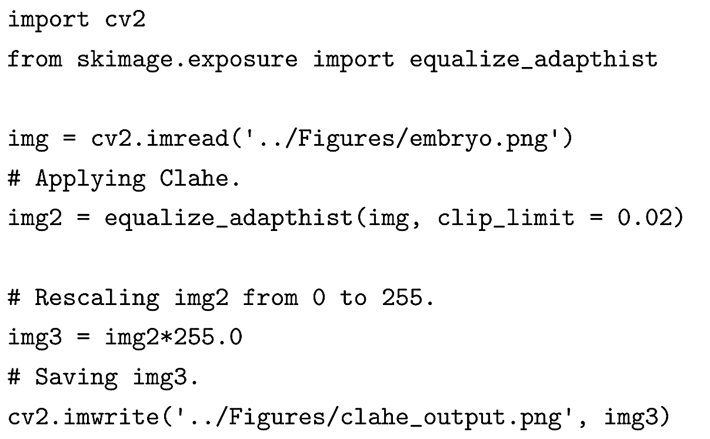
Contrast Limited Adaptive Histogram Equalization (CLAHE)

Slide 24
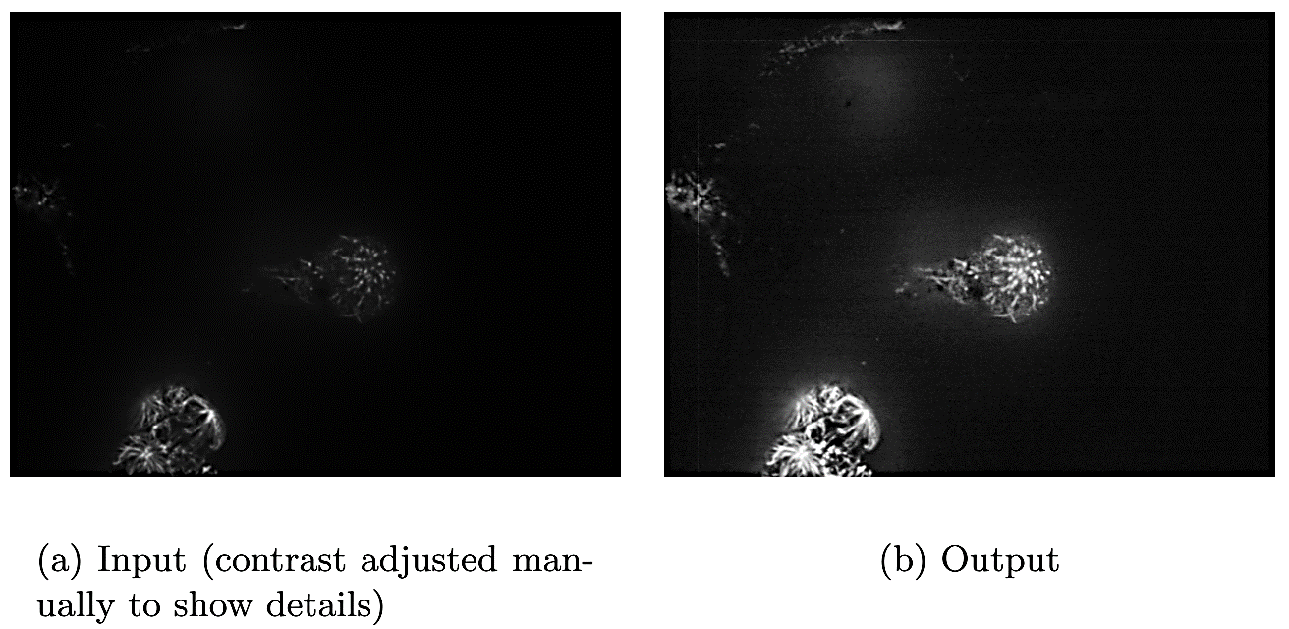
Contrast Limited Adaptive Histogram Equalization (CLAHE)

Slide 25
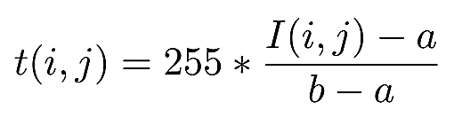
Contrast Stretching
Contrast stretching is used to increase the pixel value range by rescaling the pixel values in the input image.
Contrast stretching is similar in idea to histogram equalization except that the pixel intensities are rescaled using the pixel values instead of probabilities and CDF.
The contrast stretching transformation, t(i,j) is given by the following equation:
where I(i,j), a, and b are the pixel intensity at (i,j), the minimum pixel value and the maximum pixel value in the input image respectively.

Slide 26
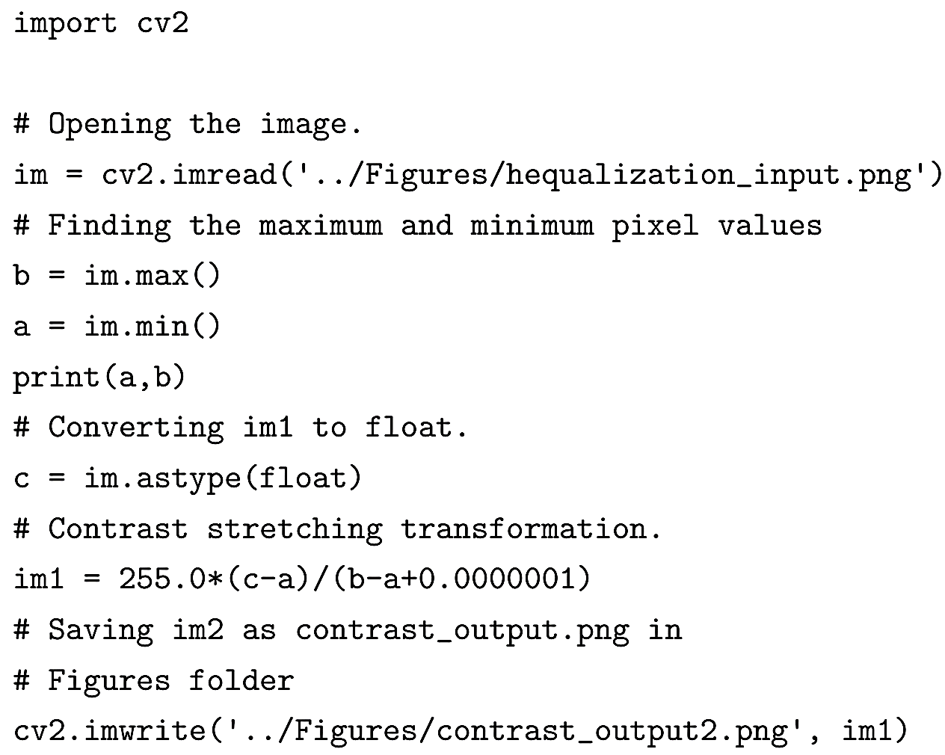
Contrast Stretching (cont.)

Slide 27
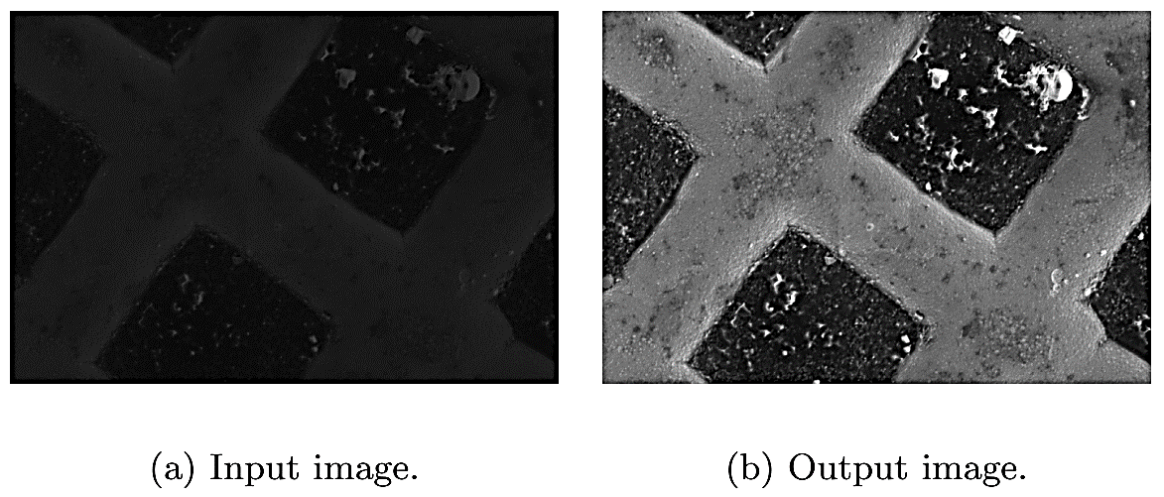
Contrast Stretching (cont.)
An example of contrast stretching where the pixel value range is significantly different from [0,255].

Slide 28
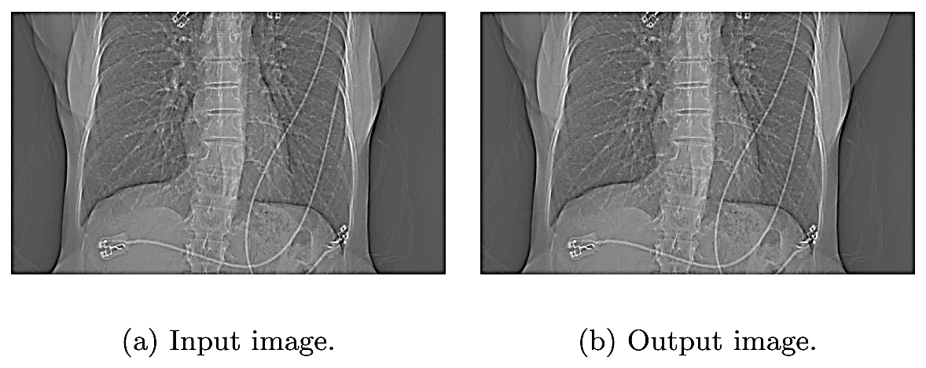
Contrast Stretching (cont.)
An example of contrast stretching where the input pixel value range is same as [0,255].

Slide 29
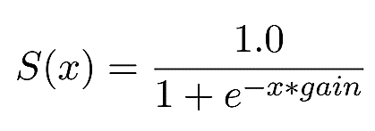
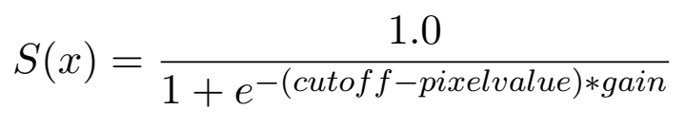
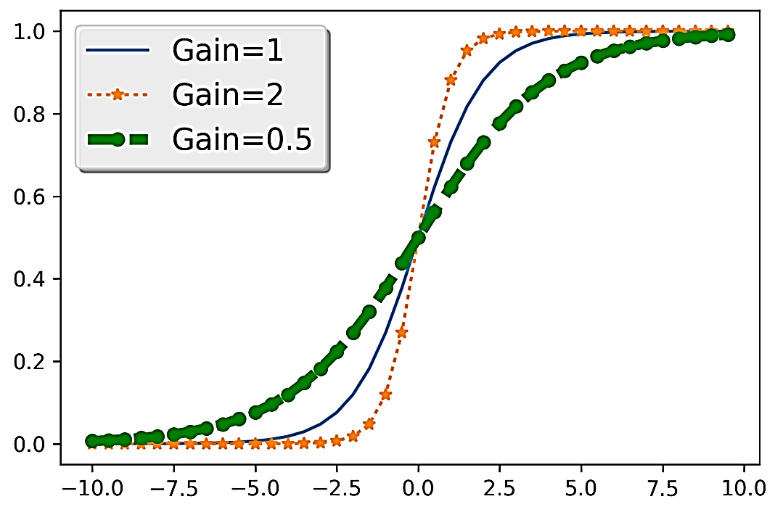
Sigmoid Correction
A sigmoid function is defined as:

Slide 30
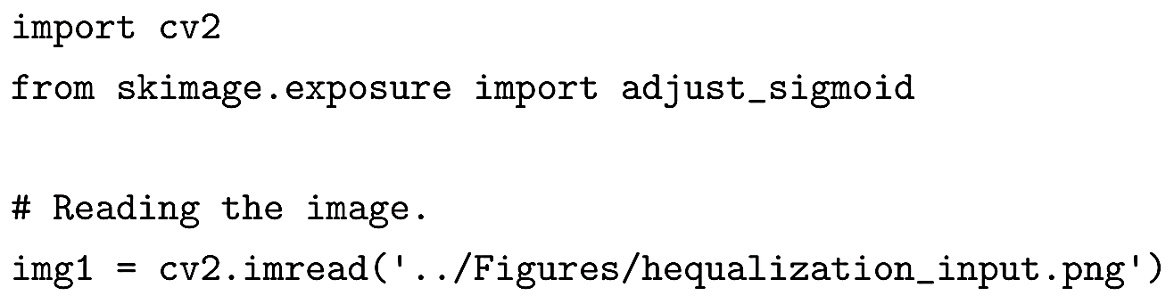
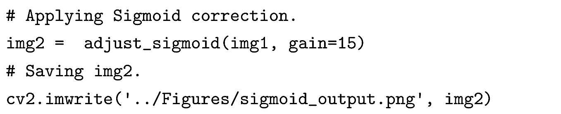
Sigmoid Correction (cont.)

Slide 31
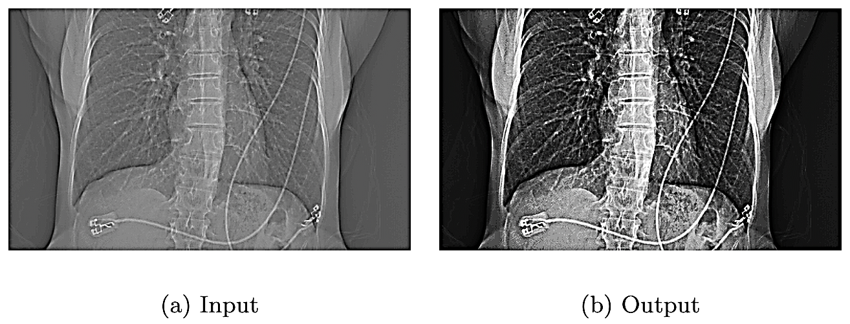
Sigmoid Correction (cont.)

Slide 32
Local Contrast Normalization
Local Contrast Normalization method demonstrates that enhancing the pixel value at a certain location depends only on its neighboring pixels and not the ones farther away from it. The method works by setting the local mean of a pixel to zero and its standard deviation to 1 based on the pixels in the neighborhood.
The method works by setting the local mean of a pixel to zero and its standard deviation to 1 based on the pixels in the neighborhood.

Slide 33
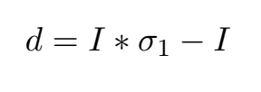
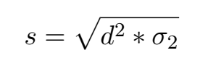
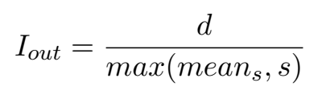
Local Contrast Normalization (cont.)
Creating a difference image (d), computed by finding the difference between the smoothed version of the image and itself.
The difference image is then used to compute the standard deviation image after applying a Gaussian smoothing.
The final image I_{out} is created by dividing the difference image by the maximum between the local mean of the standard deviation image and the standard deviation image.

Slide 34
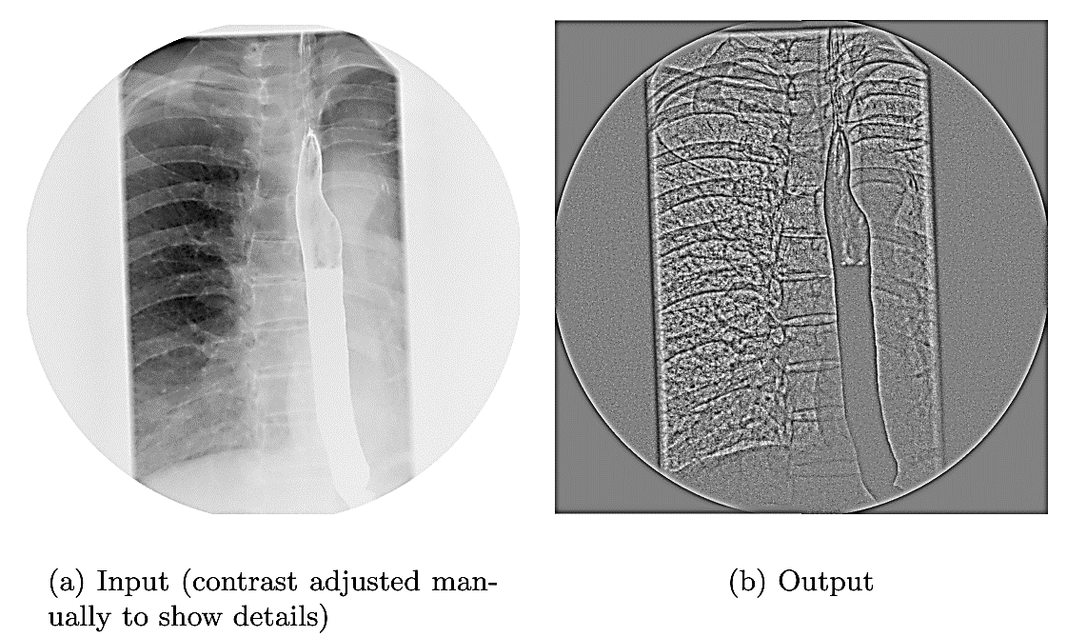
Local Contrast Normalization (cont.)

